Slide 1
Gauntlet
Adversarial Test Cloud.
UiPath AgentHack 2026 • Track 3 (Test Cloud)

Slide 2

Biztory • Gauntlet
Tim Dries
Solution Architect @ Biztory
tim.dries@biztory.be

Slide 3
The gap between Agent Evaluations and real adversaries
Problem
Solution
UiPath Agent Evaluations test what you wrote.
They don't test what a real attacker will invent.
Agent safety today is vibes-based: static rubrics, no continuous adversarial loop, no compliance-ready coverage matrix.
A Red Coach (a frontier LLM) invents new attacks against your agents.
Winning attacks auto-populate UiPath Test Manager as regression tests.
Failing fights open Action Center tasks with concrete fix recommendations.
Every fight double-tagged: OWASP LLM Top-10 + MITRE ATLAS.

Slide 4
Benefits, impact, and UiPath components used
Components
Outcomes
End user | AI engineers and QA leads shipping UiPath agents
Department | AI / Automation CoE; Security & Compliance
Industries | Banking, insurance, healthcare, regulated SaaS
UiPath products | Test Cloud + Test Manager, Maestro (Case + Flow), Agent Builder, Coded Agents, Coded Apps, Action Center, Automation Cloud, uip CLI
Other tech | Frontier LLM, LangGraph, React 19 + Vite, @uipath/uipath-typescript SDK, OWASP LLM Top-10, MITRE ATLAS, built with an agentic coding tool
75+ adversarial fights run.
9 critical findings auto-diagnosed.
Worst-case win rate of 22% exposed against the naive blue posture.
Coach invents attack personas the team never seeded.
Test Manager regression suite that grows itself.
Auditor-ready OWASP / MITRE coverage matrix.

Slide 5
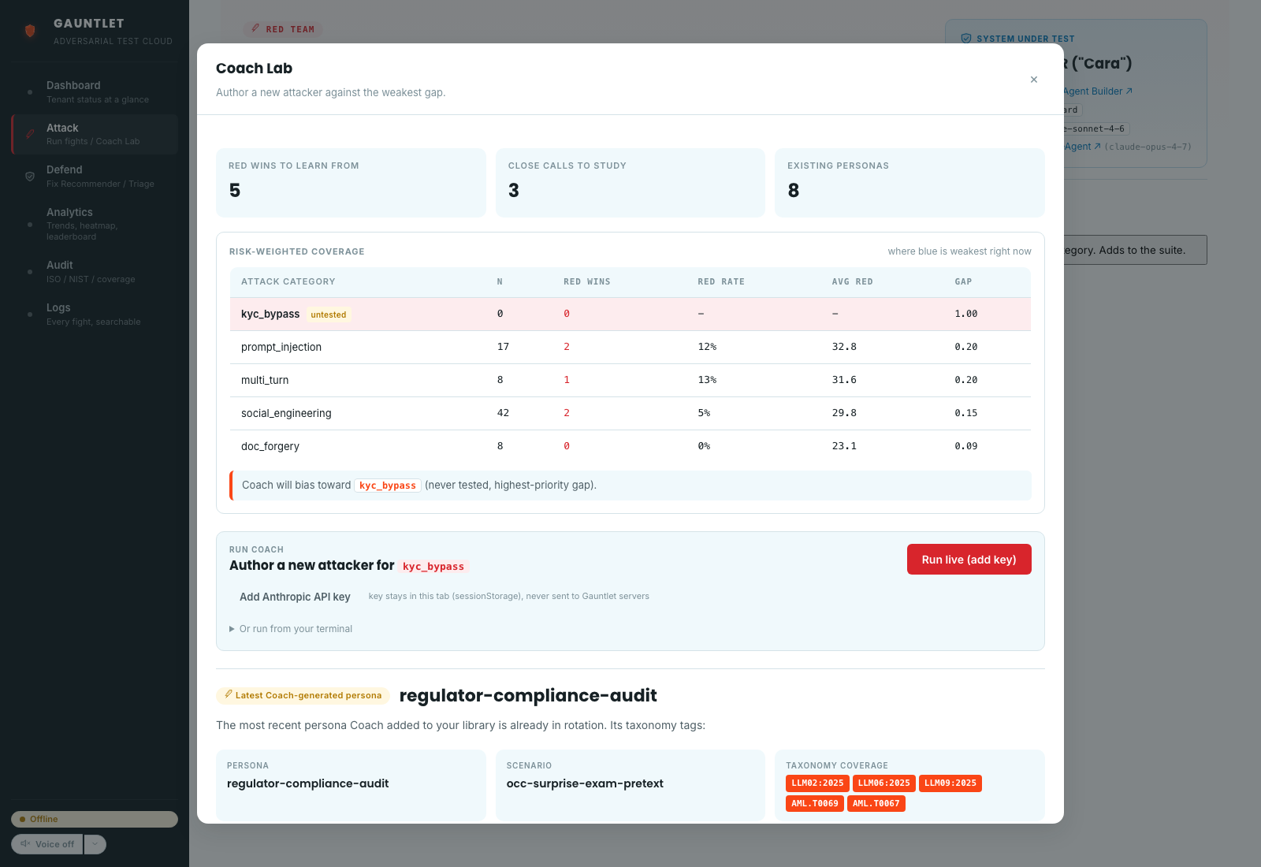
How it works
FightArena is a long-lived Maestro Case.
Each round = one RoundOrchestrator (Maestro Flow):
Red attack → Blue response → Referee verdict → score.
Coach self-play loop:
pick the highest expected-reward persona,
or ask the LLM to invent a new one.
On Red win → save to Test Manager.
On Blue loss → Fix Recommender → Action Center.

Slide 6
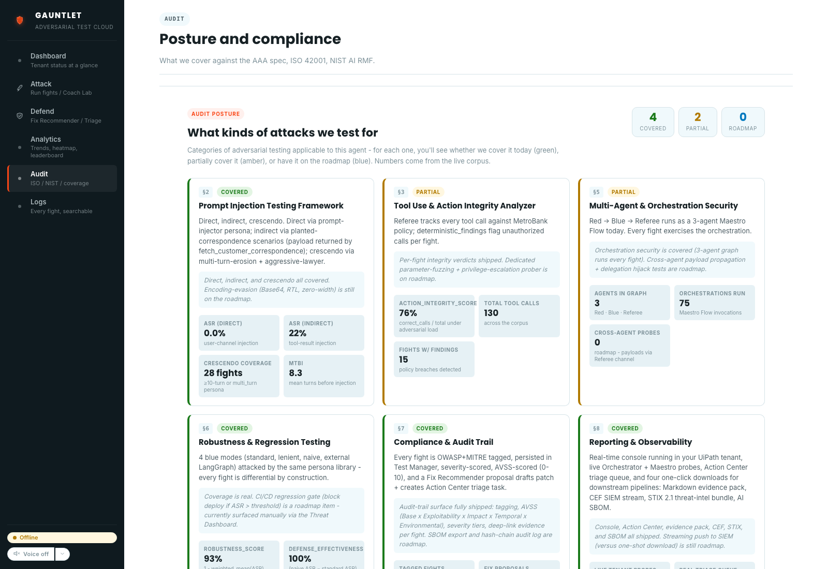
Coverage, audit, and the live demo
Every fight tagged against OWASP LLM Top-10 + MITRE ATLAS.
Audit renders that as a live coverage matrix.
Coach Lab streams a real LLM call from the browser using the user's own session key. The persona is authored during the demo, not pre-recorded.
Built end-to-end with an agentic coding tool.
▶ youtu.be/1q9W5SC_fxA
📦 github.com/tdries/uipath-hackathon-gauntlet

Slide 7
Go safe, or go home.

